Slide 1
Image Classification using Convolutional Neural Networks
205325014
Shirisha

Slide 2
Introduction to CNN
What is a CNN?
A special type of neural network trained to recognize patterns, detect objects, and classify images.
Common Architectures:
LeNet, AlexNet, GoogLeNet, ResNet, VGG, etc.
Project Goal: Build a simple LeNet-style CNN for image classification.

Slide 3
Model Architecture
Our LeNet-style CNN consists of:
2 Convolutional Layers: For feature extraction.
2 Pooling Layers: To reduce spatial dimensions.
1 Flattening Layer: To convert 2D data into a 1D vector.
2 Dense (Fully Connected) Layers: For final classification.

Slide 4
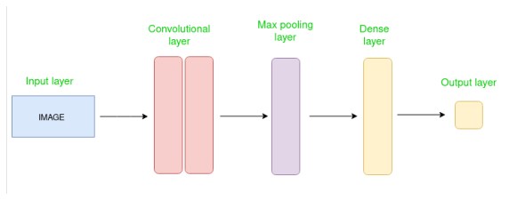

Slide 5
The CIFAR10 Dataset
Dataset Details:
Total Images: 60,000 colour images.
Categories: 10 different classes (6,000 images per class).
Data Split:
Training Set: 50,000 images.
Testing Set: 10,000 images.
Classes: Plane, car, bird, cat, deer, dog, frog, horse, ship, truck

Slide 6
Data Pre-processing: Normalization
What is Normalization
The process of changing the pixel value range from 0–255 to 0–1.
Why do we do it
High numeric values make computation complex and expensive.
Reducing values to a range between 0 and 1 makes computation faster and easier.
Method:
Divide all pixel values by the maximum value (255)

Slide 7
Data Verification
Goal: To ensure the dataset is loaded and labeled correctly before training.
Process:
Plot the first 25 images from the training set.
Display the corresponding class name below each image to verify accuracy.

Slide 8
Conclusion & Implementation
Tools Used: TensorFlow, Keras, and Matplotlib.
Next Steps:
Building the model layers.
Compiling the model with an optimizer and loss function.
Training the model on normalized CIFAR10 data.

Slide 9
THANK YOU

